Slide 1
GRAPHICS, DIGITAL MEDIA, MULTIMEDIA
Melissa Albo #1
Sagrario Casillas #4
Angela Durán #8
Daniela Martínez #16

Slide 2
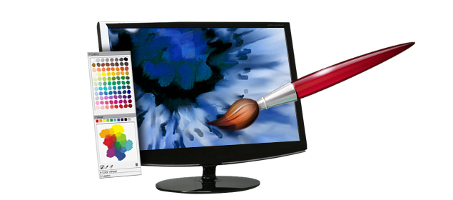
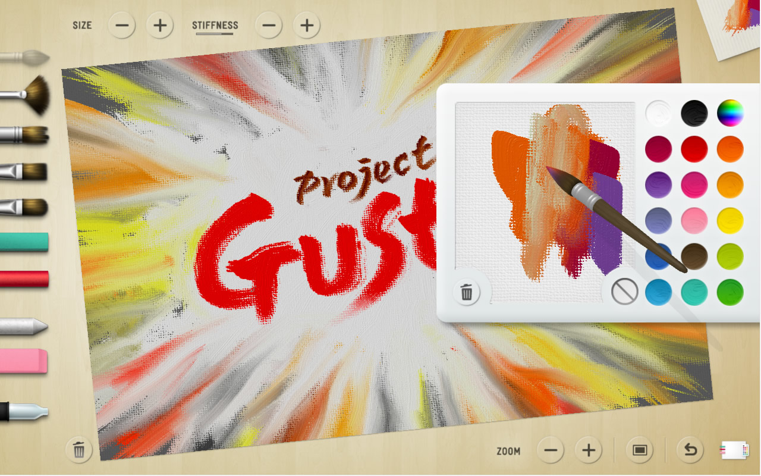
Painting Software
The painting software lets you “paint” pixels on the monitor with a pointing device.
The most common pointing devices used on this software are:
Mouse
Trackball
Stylus
touchpad
Trackball
These pointing devices translate the movements made by the user’s fingers into lines and patterns on-screen.
Typically, a painting program offers a palette of tools, in which some tools can do difficult, even impossible on paper and other tools mimic real-world painting tools.

Slide 3
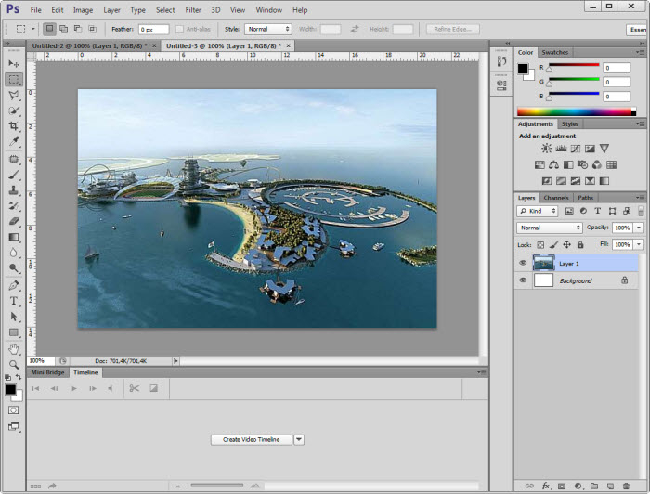
Image-Processing Software
A picture taken with a camera if often referred to as a digital picture which is a bitmapped photo.
The Image-Processing Software lets the photographer modify the picture.
Adobe Photoshop is an example of an Image-Processing software that enables you to edit high-resolution bitmapped pictures.
It can easily remove red eyes, unwanted reflections, and lets you fade away facial blemishes.

Slide 4
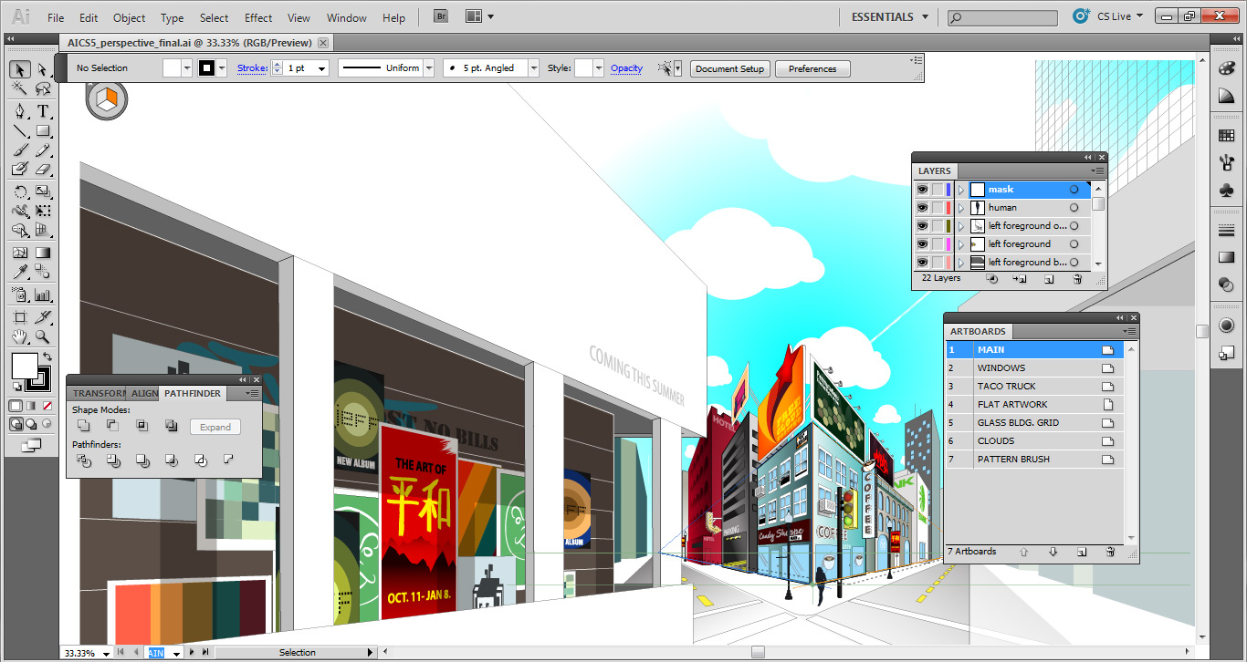
Drawing software
Stores a picture as a collection of lines and shapes instead of a collection of dots.
The software calculates mathematical formula for the line.
It uses object- oriented graphics or vector graphics because the pictures are collections of lines, shapes, and other objects.
One of the most professional drawing programs is Adobe Illustrator because it uses PDF (portable document format) to store images.
PDF: Allows documents to be exchanged between programs regardless of the software, hardware, or operating system.

Slide 5
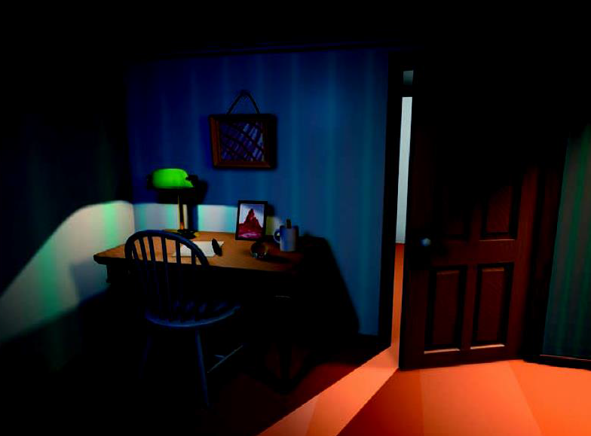
3D Modeling Software
Whether an artist is drawing a three-dimensional scene on a paper or in a computer painting program, it will appear as 3D and apparently with depth but actually the drawing lacks of depth and it is just a flat representation of the scene.
Now, graphic designers use 3D Modeling Software and with it…
3D computer models can be rotated, stretched, and combined with other model objects to create complex 3D scenes.
3D models can be rotated and viewed from different angles
You can take two-dimensional snapshots and see the figure in many points of view
Modern TV, movies and video games’ special effects are simulated 3D animation.
This scene was created using 3D Modeling Software

Slide 6
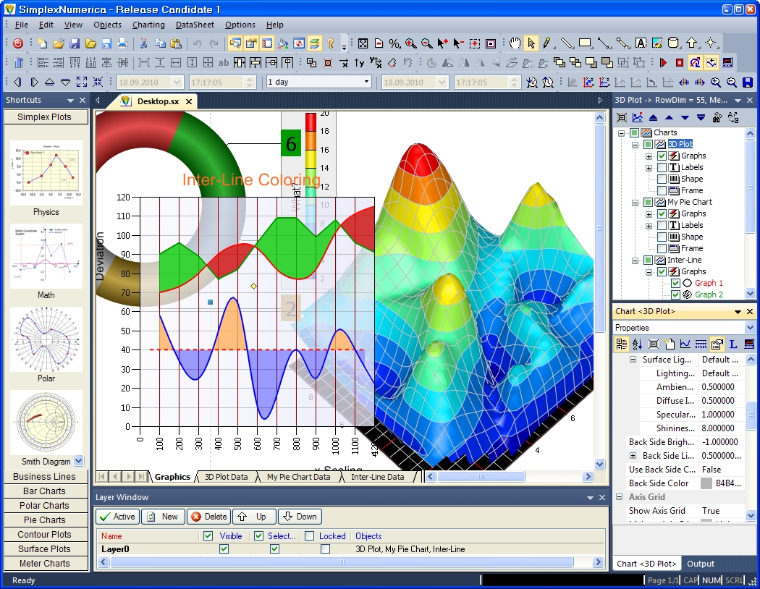
Effective technique for improving the quality of slides prepared with presentation graphic software.
The presentation-graphics software helps in the creation of visual aids for:
Lectures
Training sessions
Sales demonstration
Other presentations
The slide shows include animation, audio, and video clips along with still images. Some presentation applications can convert presentation into web pages or convert slide shows into video files.

Slide 7
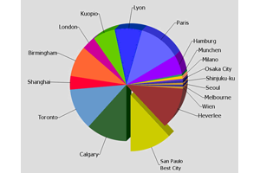
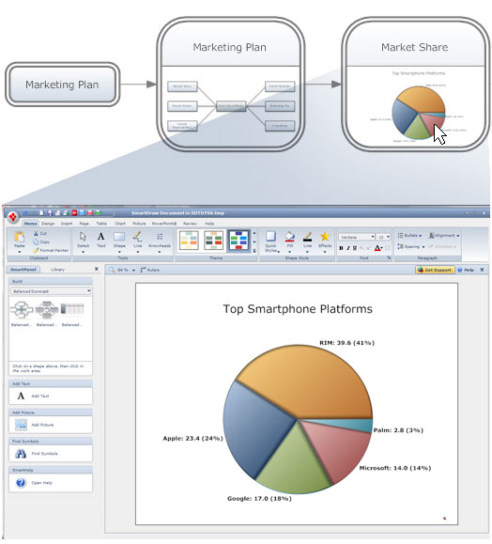
These programs are commonly used for creating and displaying “slides” to function as visual aids fot presentations.
These slides may include:
Drawings
Photographs
Charts
Tables
Spreadsheet-style

Slide 8
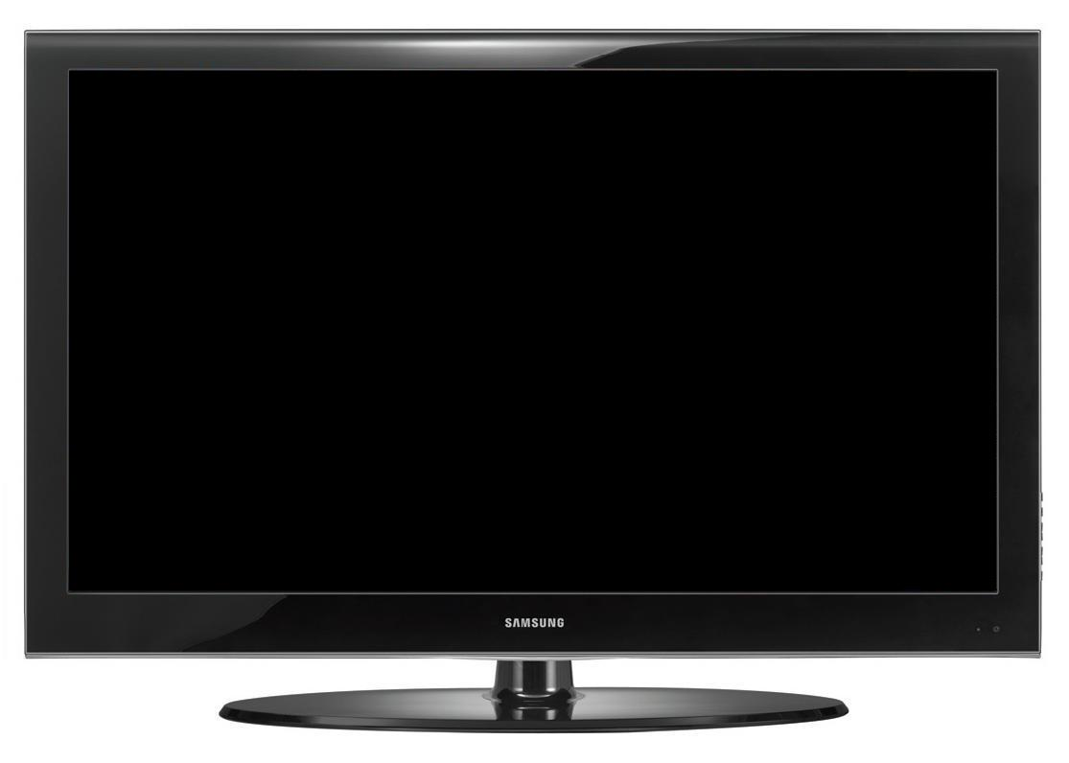
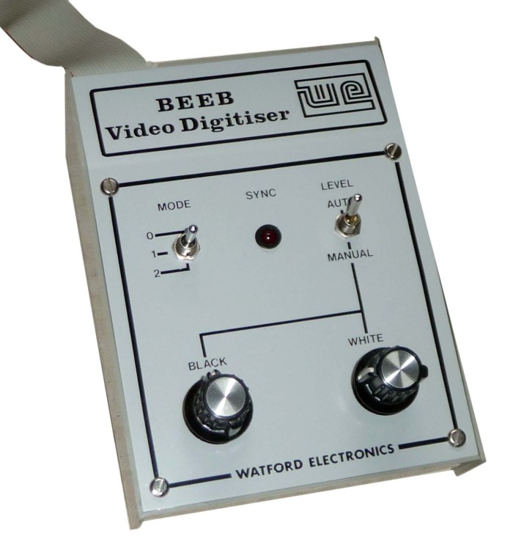
How is digital technology used in video and audio production
Analog video technology is quickly being replaced by digital technology.
Since 2009 all TV's are digital.
Analog videos and broadcasts can be digitalized with a video digitizer.
The digital camcorders can store data on mini-DV tapes, digital-8, tapes, rewritable optical discs, flash memory cards or a hard disk.
A camera connected to a computer can also bypass its own tape and transfer images directly to the computer.
Digital video can be: copied, edited,and stored without any loss of quality

Slide 9
How data compression works
Data compression is used because multimedia like movies or video clips can take a lot of space from your hard disk, they can quickly fill up the full disk or slow digital download. Data compression is used to save storage space, it decreases the amount of data that the movies have, so that hey can be stores in smaller places.
Image-compression software is used to compress graphics and video files.
Digital movies are becoming larger and longer and are even more common in everyday computing applications because compression systems are improving.
Modern media players, such as QuickTime and Windows Media Player, include the software compression systems.
May 2015
9

Slide 10
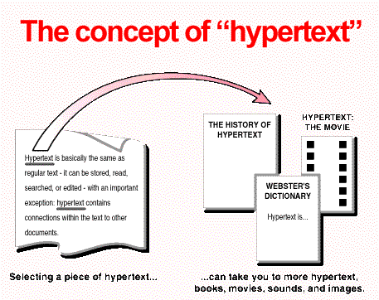
Present and future applications for multimedia technology
Hypertext
A documents that contains links that quickly leads to other part of the document
Hypermedia
A hypermedia system could combine: texts, numbers, graphics, animations, music, and other media
Multimedia
The use of music, voice, video, text, graphics, animations, etc.
Multimedia-authoring
software
Used to create/edit multimedia documents. Graphics, text files, video clips and files.

Slide 11
The biggest hypermedia platform is World Wide Web.
When you watch a TV program, you're experiencing a multimedia product.
Multimedia software titles are designed to be used with TVs and controlled by games machines and other and other set- top boxes from Sony, Microsoft, Nintendo and other companies.
PowerPoint was created for linear presentations but includes capabilities of adding hyperlinks.
World Wide Web uses metaphorical pages to represent screens and info.
Adobe Flash is created for multimedia Web applications.
Flash documents are like interactive movies.

Slide 12
References
http://www.livbit.com/article/2010/03/04/microsoft-gustav-takes-computer-based-painting-to-a-whole-new-level/
http://www.memphisprofessionalphotographer.com/workshops-2/adobe-photoshop-post-processing/
http://naturpixel.com/2010/04/13/adobe-illustrator-cs5-que-nos-trae-de-nuevo/
http://www.classicelectrics.info/crystal/crystal-reports-exporter-download-rainforest-software.html
http://www.all-freeware.com/results/involute/spline
http://www.smartdraw.com/presentations/presentation-software.htm
http://hdflatscreen.blogspot.com/2010/07/flat-screen-hd-tvs.html
http://mjpye.org/video.shtml
http://cparker.grads.digitalodu.com/2014/02/24/reading-notes-7-hypertext/
http://geoffreymultimedia.com/wp-content/uploads/2012/06/geoffrey-multimedia.jpg
http://blogs.tees.ac.uk/teltees/files/2015/02/PowerpointIcon2.jpg
http://cahiermaths.free.fr/images/gif/adobeplayerlogo.jpg

